Slide 1
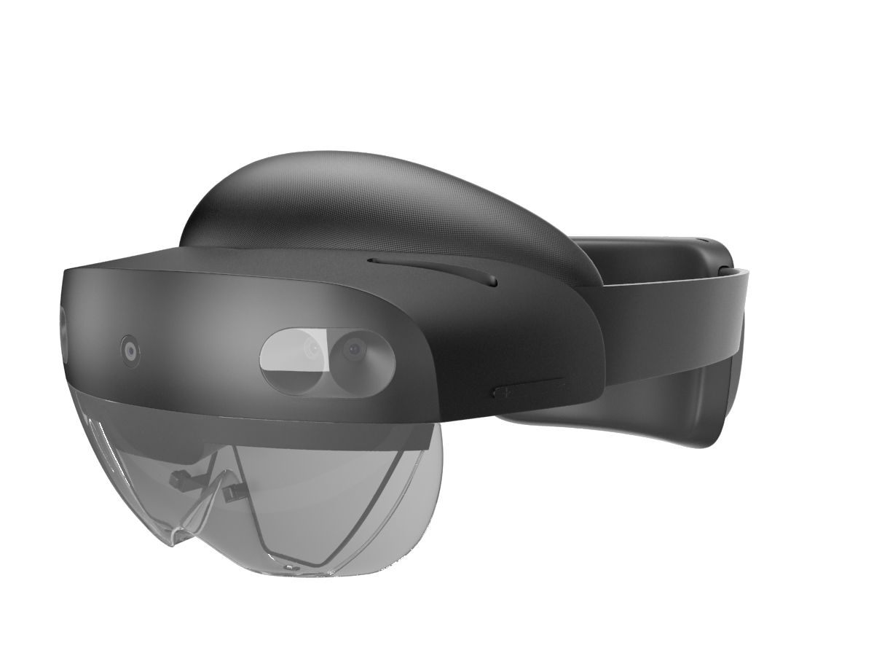
XR Industrial Project 2
SIF400 AR system 13.01.2026
Hamza Sallam
Eric Márquez
Leon Saidavi
Jorge Luis Botero

Slide 2

The concept
Enhancing the SIF 400 Line user experience by providing:
Live operational data
AI-driven image recognition.
Key technologies: Hololens2, Unity, APIs, image recognition.

Slide 3

Project Overview
What We Built:
An end-to-end smart manufacturing monitoring system combining:
Industrial automation (SMC SIF-402/405 stations)
Real-time data middleware (Node-RED)
Augmented Reality visualization (HoloLens 2)
AI image recognition system
Key Innovation: Hands-free, real-time monitoring of industrial processes through AR glasses with AI-assisted quality control

Slide 4
Development Process
Phase 1
Phase 3
Phase 2
Phase 4
Planning & Architecture
Integration & Testing
Parallel Development
Production Deployment

Slide 5
Technologies Used:
SMC SIF-402/405
Unity
OPC UA
HoloLens 2
AI Vision
Node-RED
Unity 2022.3 + MRTK 2.8.3
Production Machines
Siemens PLCs
Container classification model

Slide 6
System Architecture
Layer 1
SMC Machines SIF-402 and SIF-405
Layer 2: Node-RED
(Running on a Server)
Industrial
MIDDLEWARE
APPLICATION
VISUALIZATION
Layer 3
Unity + MRTK + C#
Layer 4
HoloLens 2
AI Vision
Notes:
Layer 1
Binary object-oriented format
Layer 2
In node-red three flows were implemented, each one:
Collecting data via OPC-UA from the respective station PLC
transform and group data into JSON format to standardize messaging to upper layers
define API endpoint within node-red, through which the data is accesible by Unity scripts
Layer 3: Unity Application (570+ lines C#)
ApiDataManager: Contioue-based polling every 3 seconds
Modular Design: Swappable mock/live data providers
Layer 4:
Frontend of our application
HoloLens 2 Visualization

Slide 7
Key Features & Capabilities
Augmented Reality
Intelligent Features
Monitoring
Industrial Integration
Developer-Friendly
Notes:
1
Live hopper level and caps counts
Instant alarm notifications
2
Natural hand gestures for interaction
Spatial UI positioned in 3D space
Color-coded status indicators
3
OPC UA protocol support that is Compatible with Siemens PLCs
Zero production interruption
Scalable to multiple machines
4
AI-powered quality control
Automated defect detection
5
Modular architecture
Mock data for offline development
Comprehensive error handling

Slide 8
Performance & Results
Code Metrics:
Unity: 570+ lines of C# across 7 modular scripts
Key Achievements
✓ Production-ready deployment on HoloLens 2
✓ Real-time visualization of industrial equipment data
✓ Hands-free operation for factory floor
✓ Scalable architecture for additional machines
System performance
API latency <100ms
Data refresh 3 seconds
Hand Tracking <20ms latency

Slide 9
Technical Challenges
01
02
03
Multilayer network
MRTK INTERACTION
Build configuration
Missing network capabilities across 4 layers.
Missing MRTK-specific components
Build Type set to "XAML" instead of "D3D Project"
Notes:
1.
Solution:
Unity: Allow HTTP downloads and Enable PrivateNetworkClientServer
Node-red, windows firewall: Allow port 1880
2.
Solution: Implemented 4-component stack per button:
Interactable (state management)
PressableButton (press detection)
NearInteractionTouchable (hand proximity)
Box Collider (physics boundary)
Impact: Natural hand-based interaction
3.
Changed Unity build settings, complete rebuild
Impact: Enabled full spatial computing model
Others: Versioning control: Github features novelty for the team.

Slide 10

Video overview!

Slide 11
Computer Vision
Adding the final phase, about what the machine does not know

Slide 12
Why We Build AI
Machine data only shows internal states
Missing critical setup information:
These conditions directly affect safety & correctness
→ We add AI-based visual understanding
Is there a cup?
What type of cup?
Is the machine physically on or off?

Slide 13
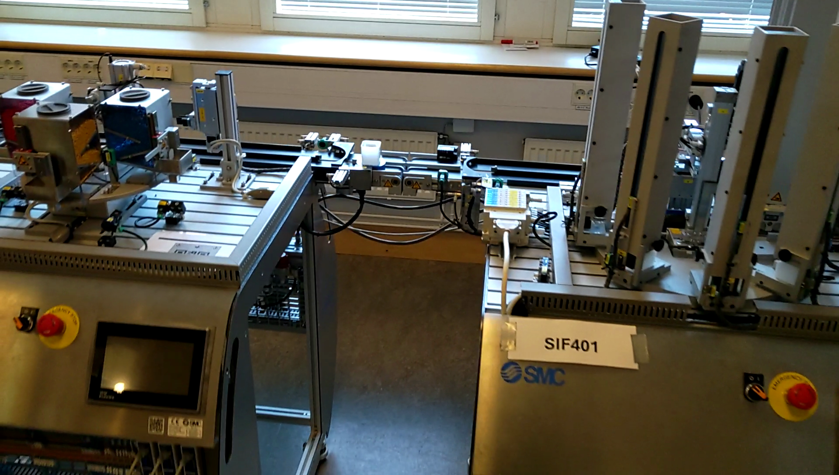
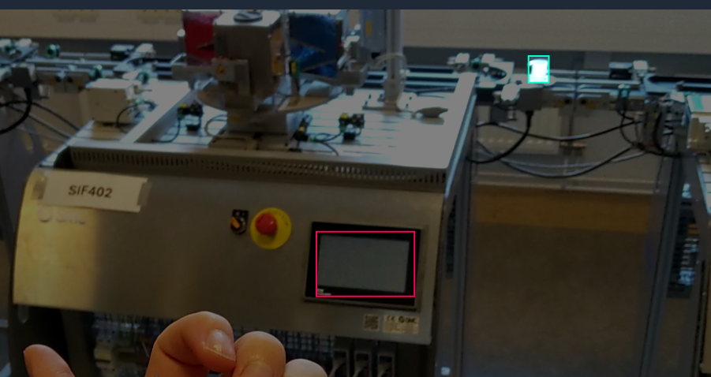
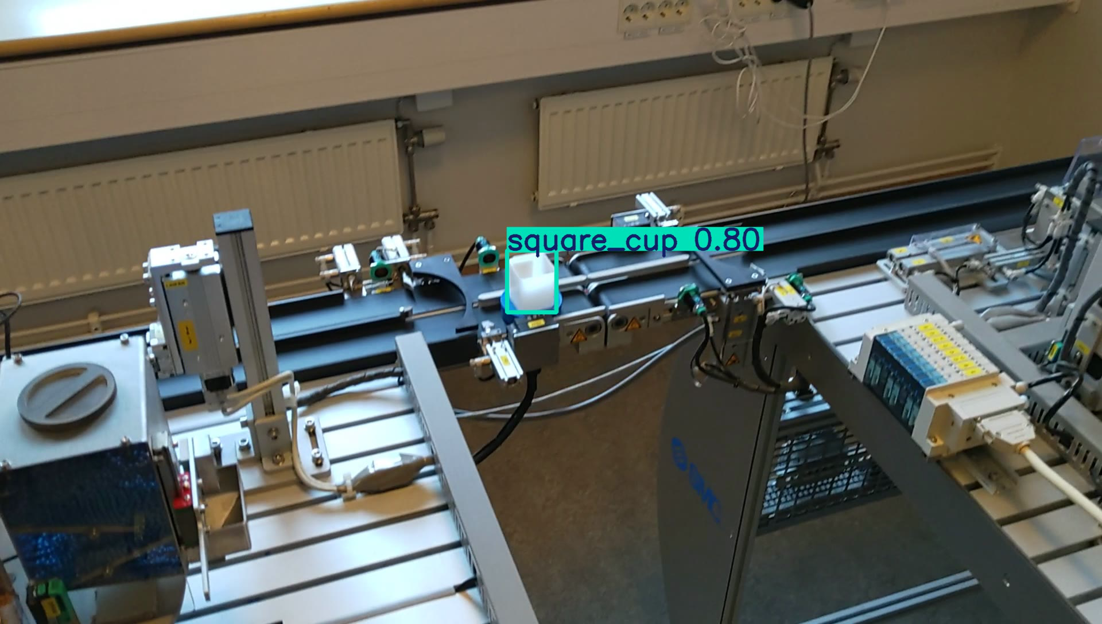
Data & Labeling
Collected images of real working scenarios
1
2
3
Labeled all data using Roboflow
Trained costum model

Slide 14
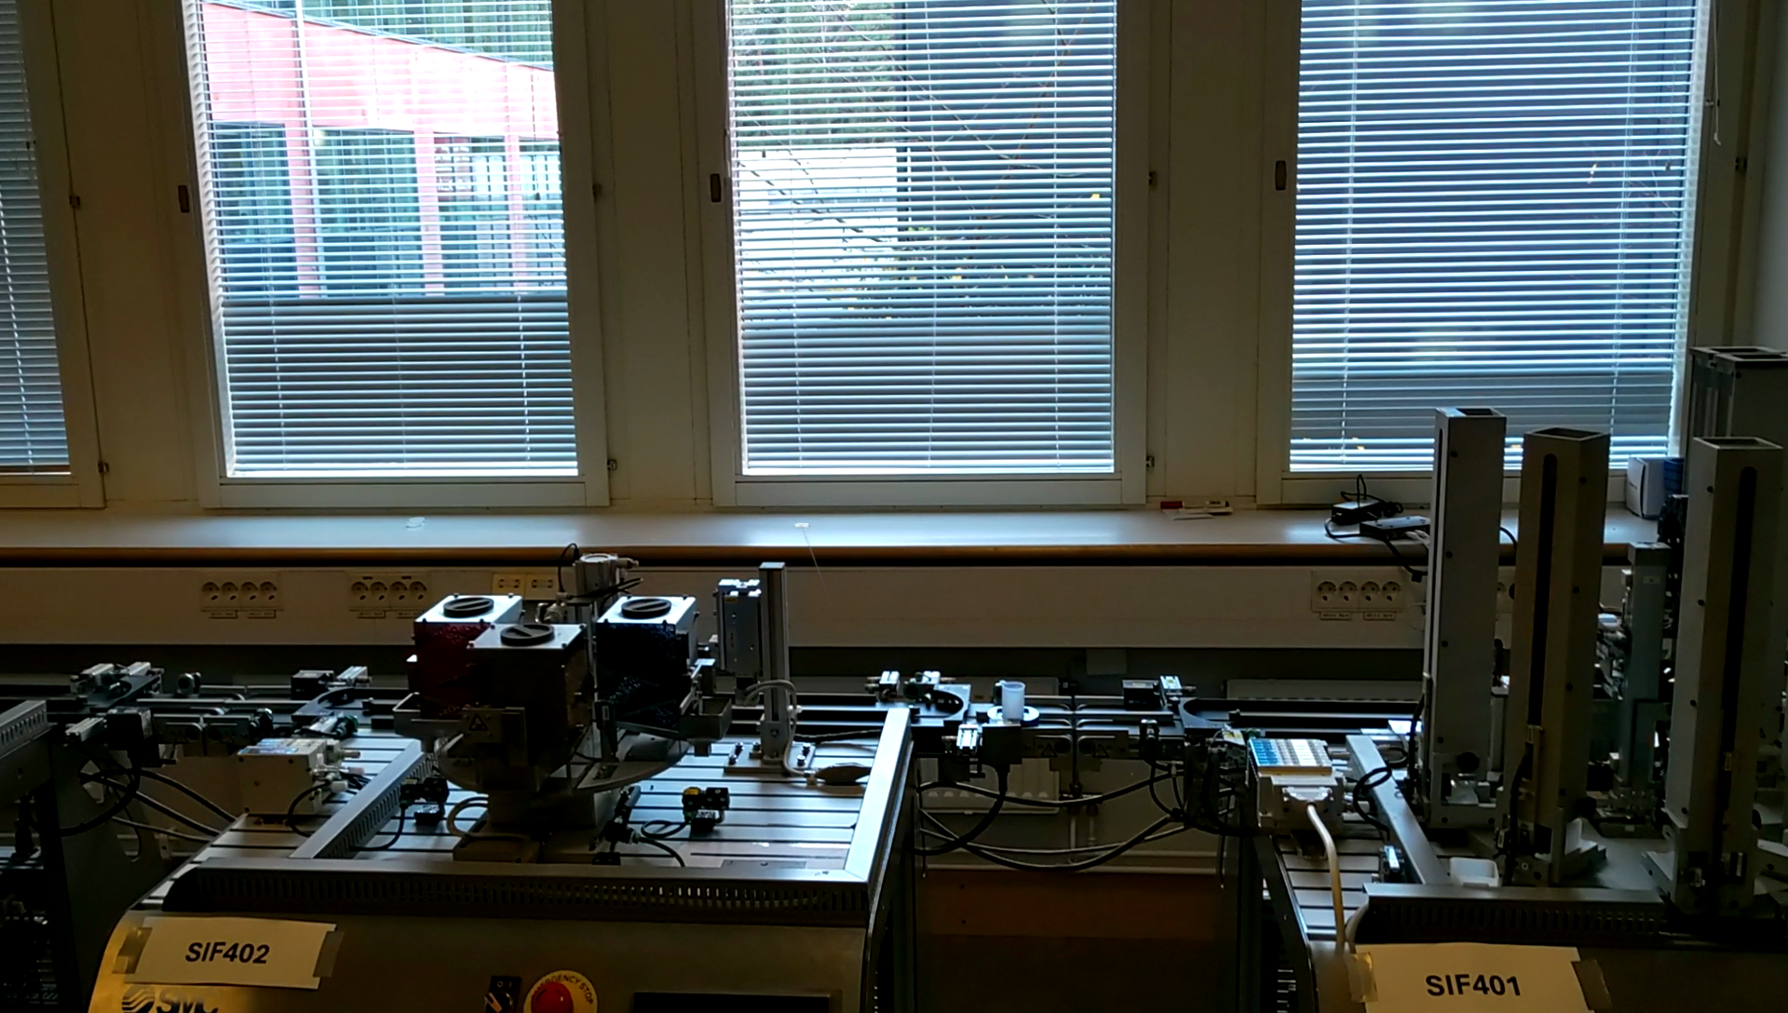
Training the AI Model
Metrics
MAP@50 -> 98.1%
Precision -> 96.8%
Recall -> 92.3%
385 Images, Split 90/5/5
[{'predictions': {'image': {'width': 1920, 'height': 1088}, 'predictions': [{'width': 30.0, 'height': 44.0, 'x': 1088.0, 'y': 751.0, 'confidence': 0.7976822853088379, 'class_id': 2, 'class': 'round_cup', 'detection_id': '05b8aa1a-b6d0-4701-83de-19d797fc06fd', 'parent_id': 'image'}]}}]

Slide 15


System Integration
Adds environmental awareness to the digital twin
AI runs on one computer
XR system uses this information to validate setup
Detection results sent to another computer

Slide 16
System Requirements
Stable Internet Connection
Camera System
XR Hardware
Computing Infrastructure
Required for AI model inference and communication between components
For capturing the physical environment and providing input to the AI model
XR headset or compatible device for visualization and interaction
Server or workstation to run Node-RED, AI model, and Docker containers

Slide 17
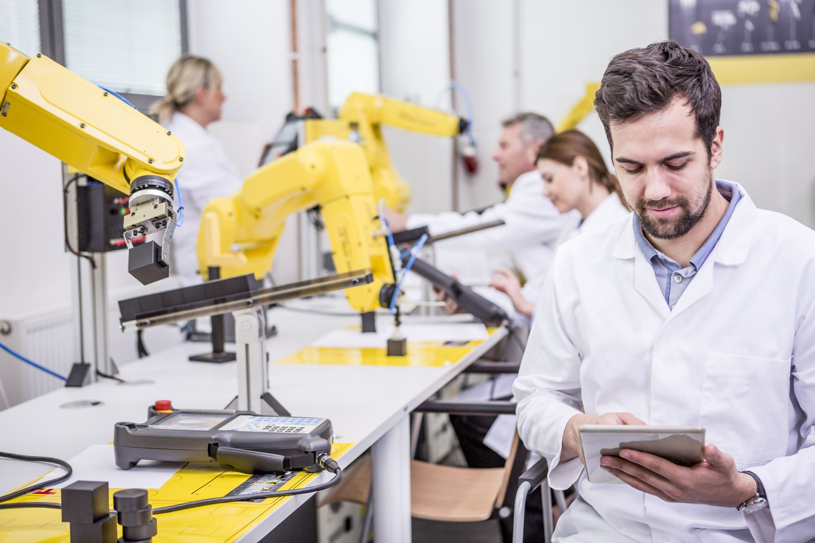
Operational Impact in the Industry
Operational Uptime
AI-driven diagnostics and troubleshooting
Contextual preemptive guidance
Enhanced Workforce
Scalable JIT training
Streamlined operation: crucial data available, no retrieval efforts.
Quality assurance
Training's performance can be messured.
Updates In the training can be deployed instantly.

Slide 18
Potential ROI improvements
30-50%
20-30%
40-60%
Faster training
Less downtime
Training effectiveness
Aug. Reality training faster to deploy and perform.
Error avoidance, higher mean-time to repair
Decreased error rates.
https://www.ptc.com/en/resources/augmented-reality/infographic/industrial-ar-high-tech-manufacturing
https://www.microsoft.com/en-us/dynamics-365/blog/business-leader/2022/03/24/manufacturers-are-mitigating-disruptions-with-hololens-2-and-dynamics-365-mixed-reality-solutions/
https://www.automation.com/article/real-roi-ar-manufacturing-beyond-hype

Slide 19
Ethical Challenges
01
02
03
Privacy
Health
Exploitation
Users could be tracked in every movement, action and comment they make.
Extended use of xR devices have negative and still not fully understood health consequences.
Companies could push efficiency to limits that are unsustainable for workers, and make layoff decisions based on these metrics.

Slide 20

02
Trends
You can enter a subtitle here if you need it

Slide 21

Elevated investments Custom infrastructure Lacking connectivity Fragmented tech frameworks Ethical concerns Regulation gray-zone
Critical Challenges for massive adoption

Slide 22

Our project's limitations
Aging technology (HoloLens2 Discontinued)
Interfacing: 100% custom made.
Abandoned or deprecated repositories.
Lacking documentation.
SIF 400's rudimentary external communication
Image recognition requires vast computing power and/or cloud services.
APIs creation and maintenance is resource intensive.
Extended use poses adoption challenges.
Commercially available gear has low energy autonomy and processing power.

Slide 23
What we learned as a Team
System integration is significantly more challenging than building individual components
Agile development principles (Scrum) helped keep the team aligned and aware of progress
Clear task distribution increased development efficiency
Continuous testing was essential when combining XR, AI, and machine data
Communication across technical domains (AI, XR, IoT) was critical for success
Early prototyping helped identify system limitations and risks

Slide 24
Thank you for listening!

